Slide 1
Rapid Review Final Presentation
Product Owner & Dev: Jiemas Rubio
Developers: Serene Cheng, Tiffany Guan, Zachary Venzor, Jianwen Wu
Notes:
have draft done by monday

Slide 2
Brief introduction into problem/application domain
Advanced study features available in popular flashcard study tools are increasingly hidden behind paywalls.
We aim to recreate the basic functionality of flashcards, generated multiple choice, and FRQ-based tests in order to improve studying efficiency without having to pay for a premium experience.

Slide 3
Goals
MVP (Achieved)
As a student, I want to transfer my notes into flashcards, so I can study in a variety of active ways.
As a student, I want to organize my flashcards into sets, so I can study cards that are relevant to each other.
As a student who uses various study platforms, I want to use flashcards from other places on this website, so I don’t waste time creating sets that already exist.
As a student, I want to practice answering multiple-choice questions created from my flashcards, so that I can study in an active way.
As a student, I want the wrong options in the multiple-choice questions to be relevant to the question, so I study better.
Defect Free Product (Unachieved)
Still some bugs left not fixed (minor)
Notes:
Kev

Slide 4
Biggest challenges
Many of us were new to full stack development so some user stories had a larger learning curve than others
Implementation of the LLM (None of us have worked with LLM/in development before)
Git workflow (Had some merge conflicts here any there every sprint but got better as sprints continued)
LLM prompting (Sometimes results still inaccurate)
Frontend Unit Tests
Notes:
Kev

Slide 5
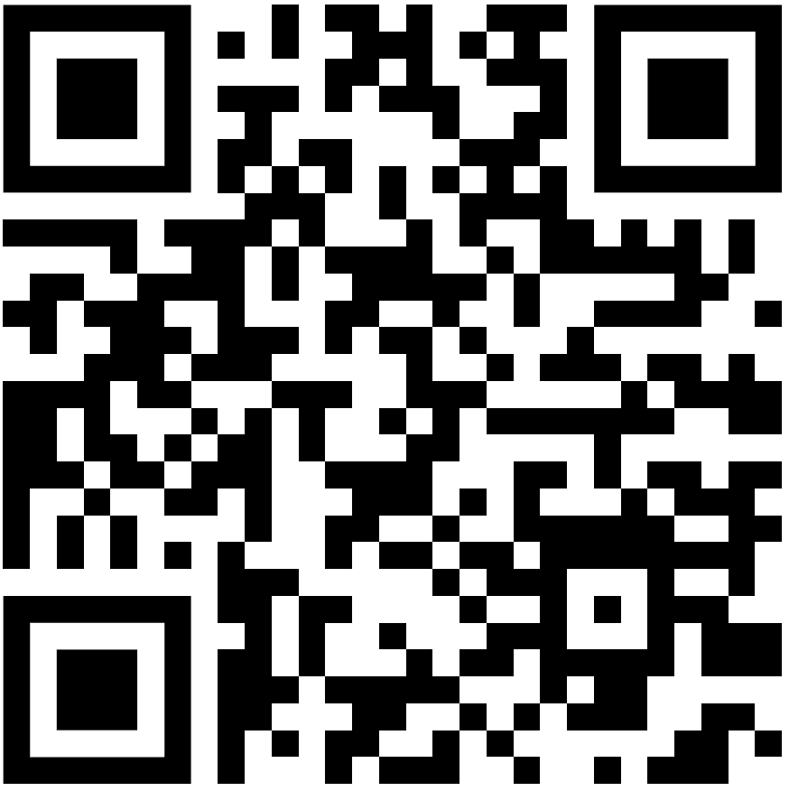
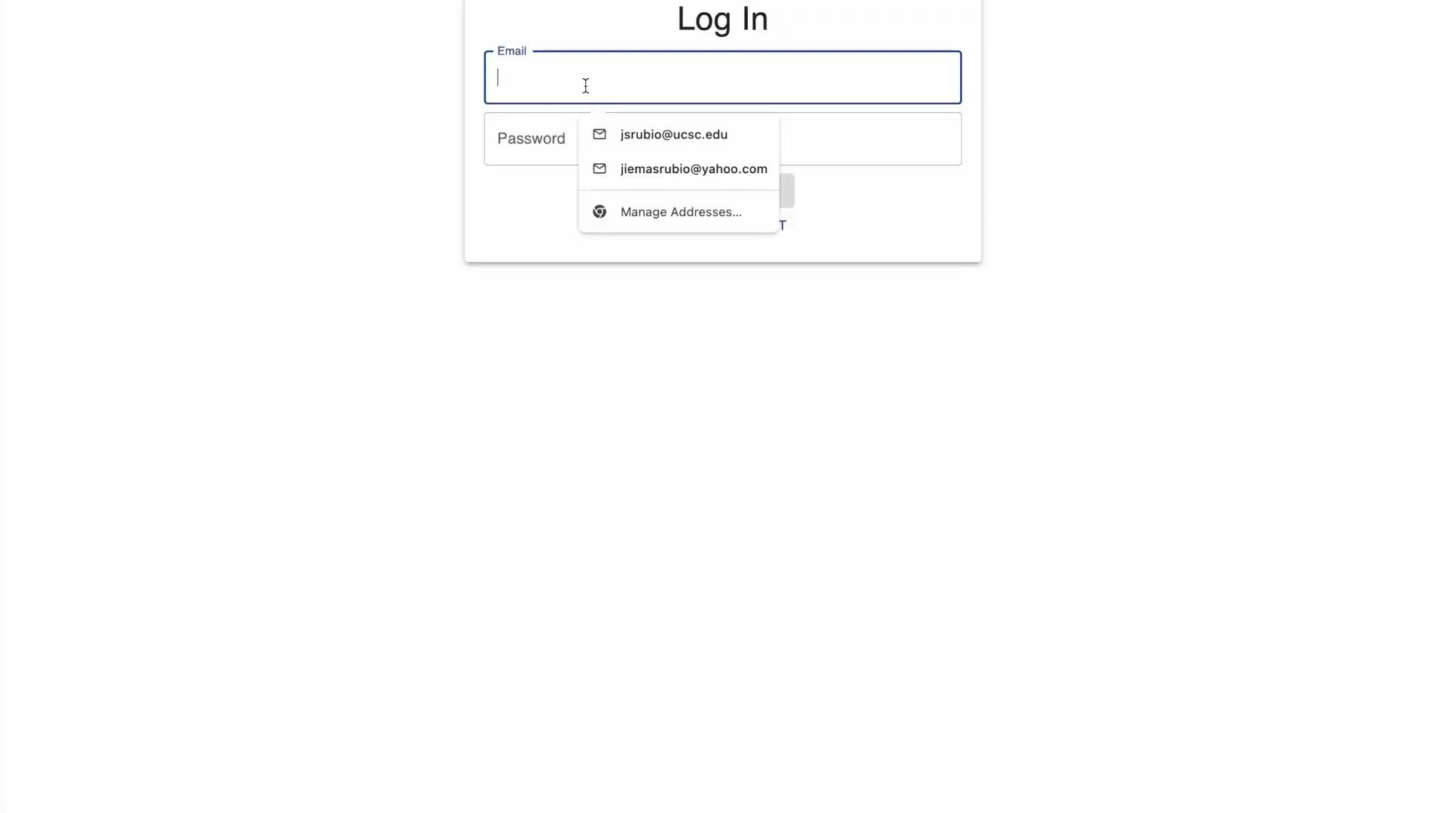
Video Demo
Notes:
Live Demo:
Start at login page
Create a new account
Email: live@demo.com
Password: 1234
Login with new account
Go to homepage
Press Create new set
Create a new set
Set name: Live Demo Set
Description: For live demo
Press Create Set
Press Back button
Live Demo Set now shown in homepage
Go to Live Demo Set
Modify first card (empty one)
Create another card w/ random data
Press Update Set
Press Import
Import an already copied string
Import those cards
Press Quiz Me
Use dual-type quiz
Press random answers
Demonstrate answer checking
Log out
Login to mail@mail.com
Show a set with AI button pressed
Show quiz with AI options
The end

Slide 6
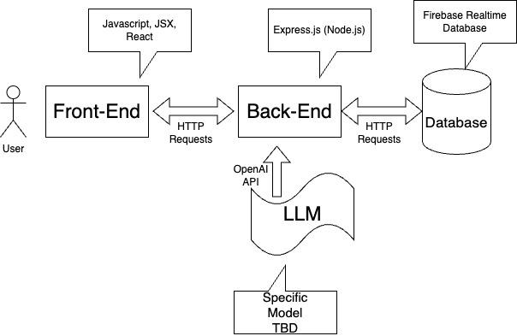
System Architecture

Slide 7
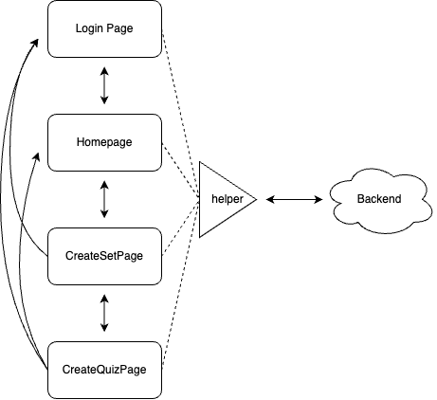
Frontend Diagram

Slide 8
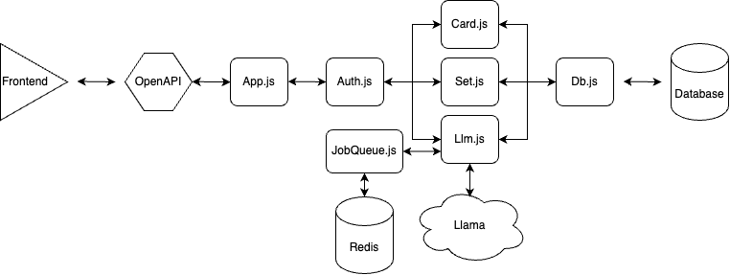
Backend Diagram

Slide 9
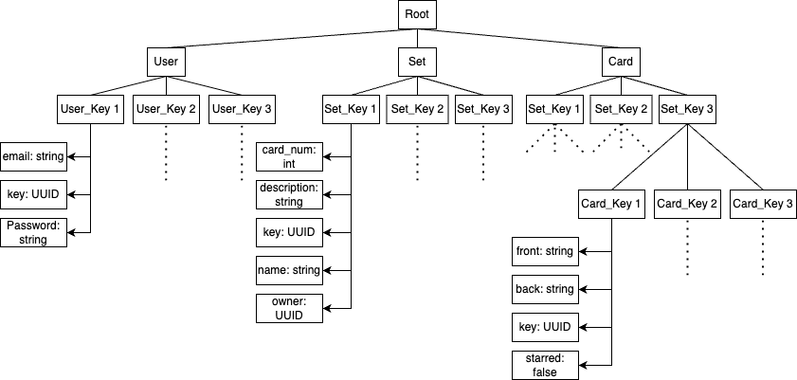
Database Diagram

Slide 10
Technologies We Used
Frontend
React, MUI, JSX, Typescript
Backend
Express.js (node.js), OpenAPI, Redis
Database
Firebase Realtime Database
LLM
Llama 3.2 API
Deployment
Vercel (Frontend), Render (Backend)

Slide 11
Project Management Techniques We Used
Project management
3 Weekly stand up meetings
Jira (Scrum Board)
Google Drive
Discord (Communication & Stand Up)
Development Environment
Github
VSCode

Slide 12
Things We
– Enjoyed
challenge of learning how to implement an LLM
designing the UI of our project
rotating the roles of scrum master
working collaboratively on a coding project
– Didn’t enjoy
writing frontend unit tests
refactoring components with too many lines of code
trying to figure out each other’s code

Slide 13
Lessons learned
Worked
Prettify and lint code before pushing to remote
Pull from dev_branch into all currently working branches whenever dev_branch is updated
Good GitHub repository management
Didn’t work
Standup meetings: tardiness and running over time
In the future
prevent merge conflicts

Slide 14
THANK YOU!

